Slide 1
Color Analysis
Student 4
Spring 2023-ART-4320 Digital Photography ll

Slide 2
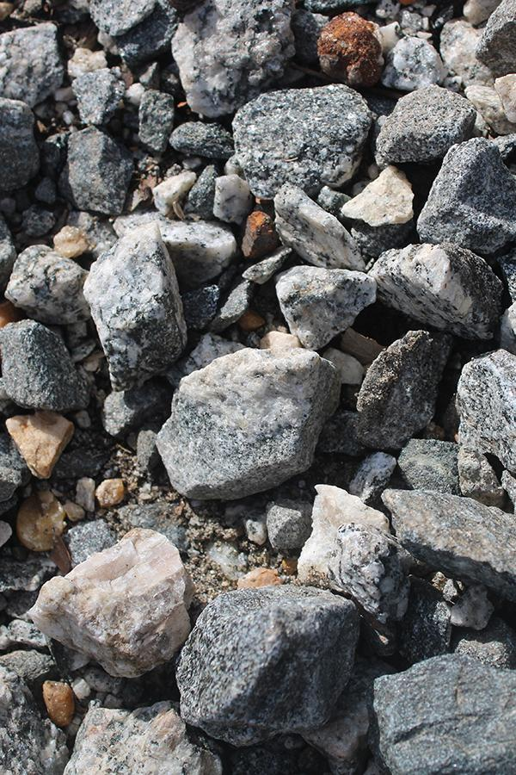
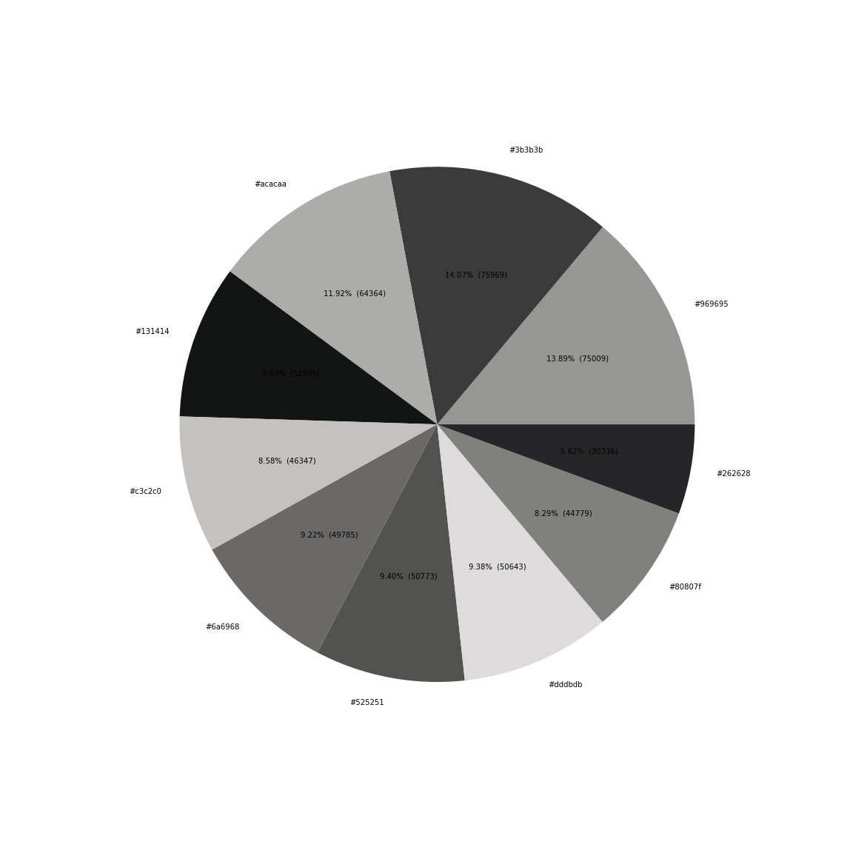
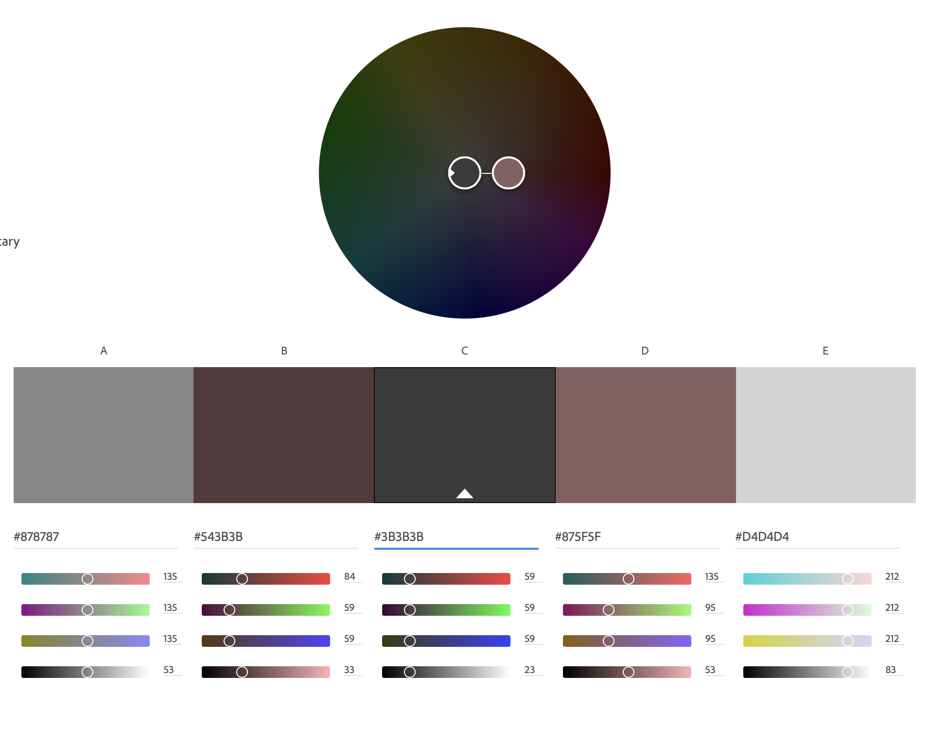
Monochromatic
A monochromatic of earth tone colors that reflect the grayscale in mineral form located northeast of Hall Patterson.
#3b3b3b (14.07%)
#969695 (13.89%)
#acacaa (11.92%)
#131414 (9.63%)
#525251 (9.40%)
#dddbdb (9.38%)
#6a6968 (9.22%)
Python focuses more on the gray dark tones while Adobe color gives the most prominent percentage of a slight brownish red contrast.

Slide 3
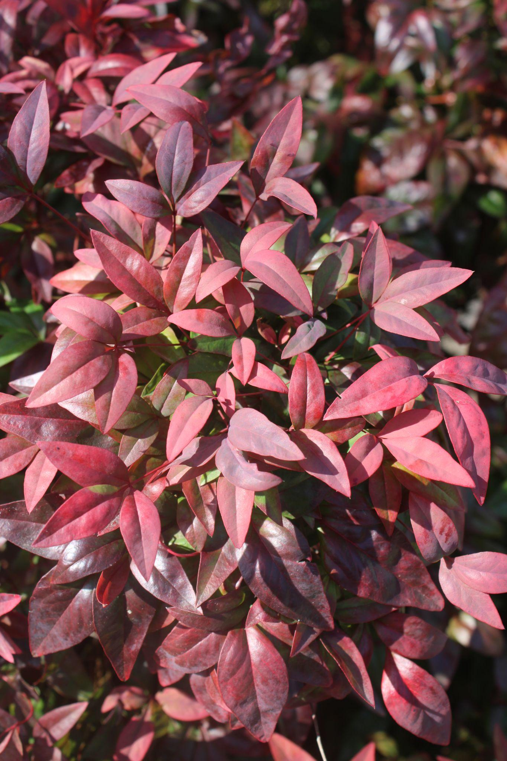
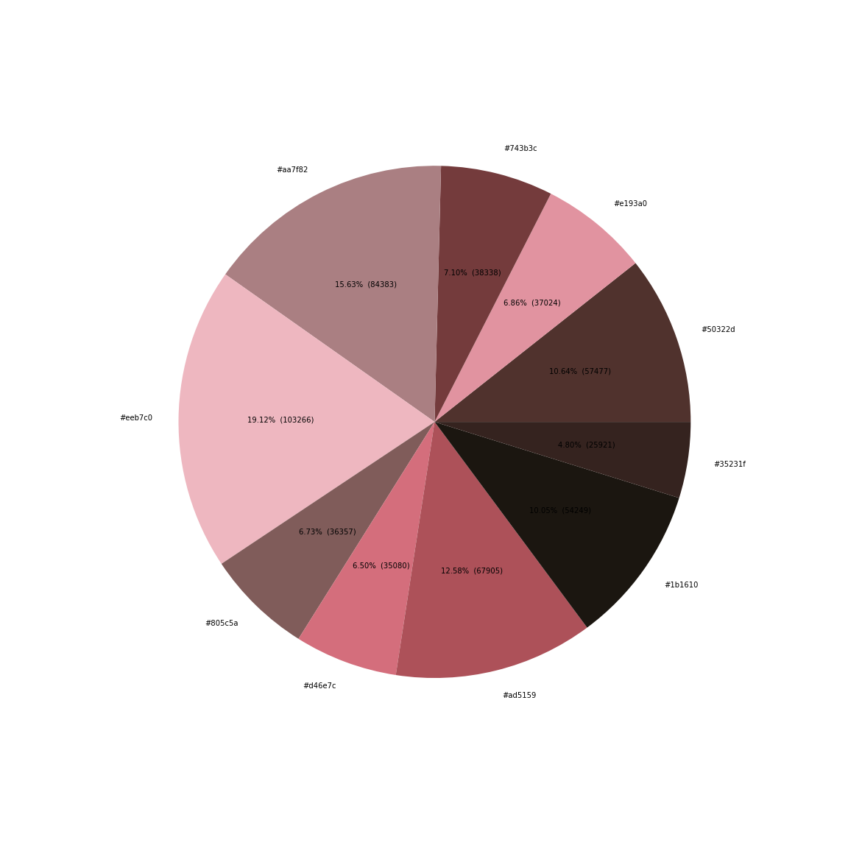
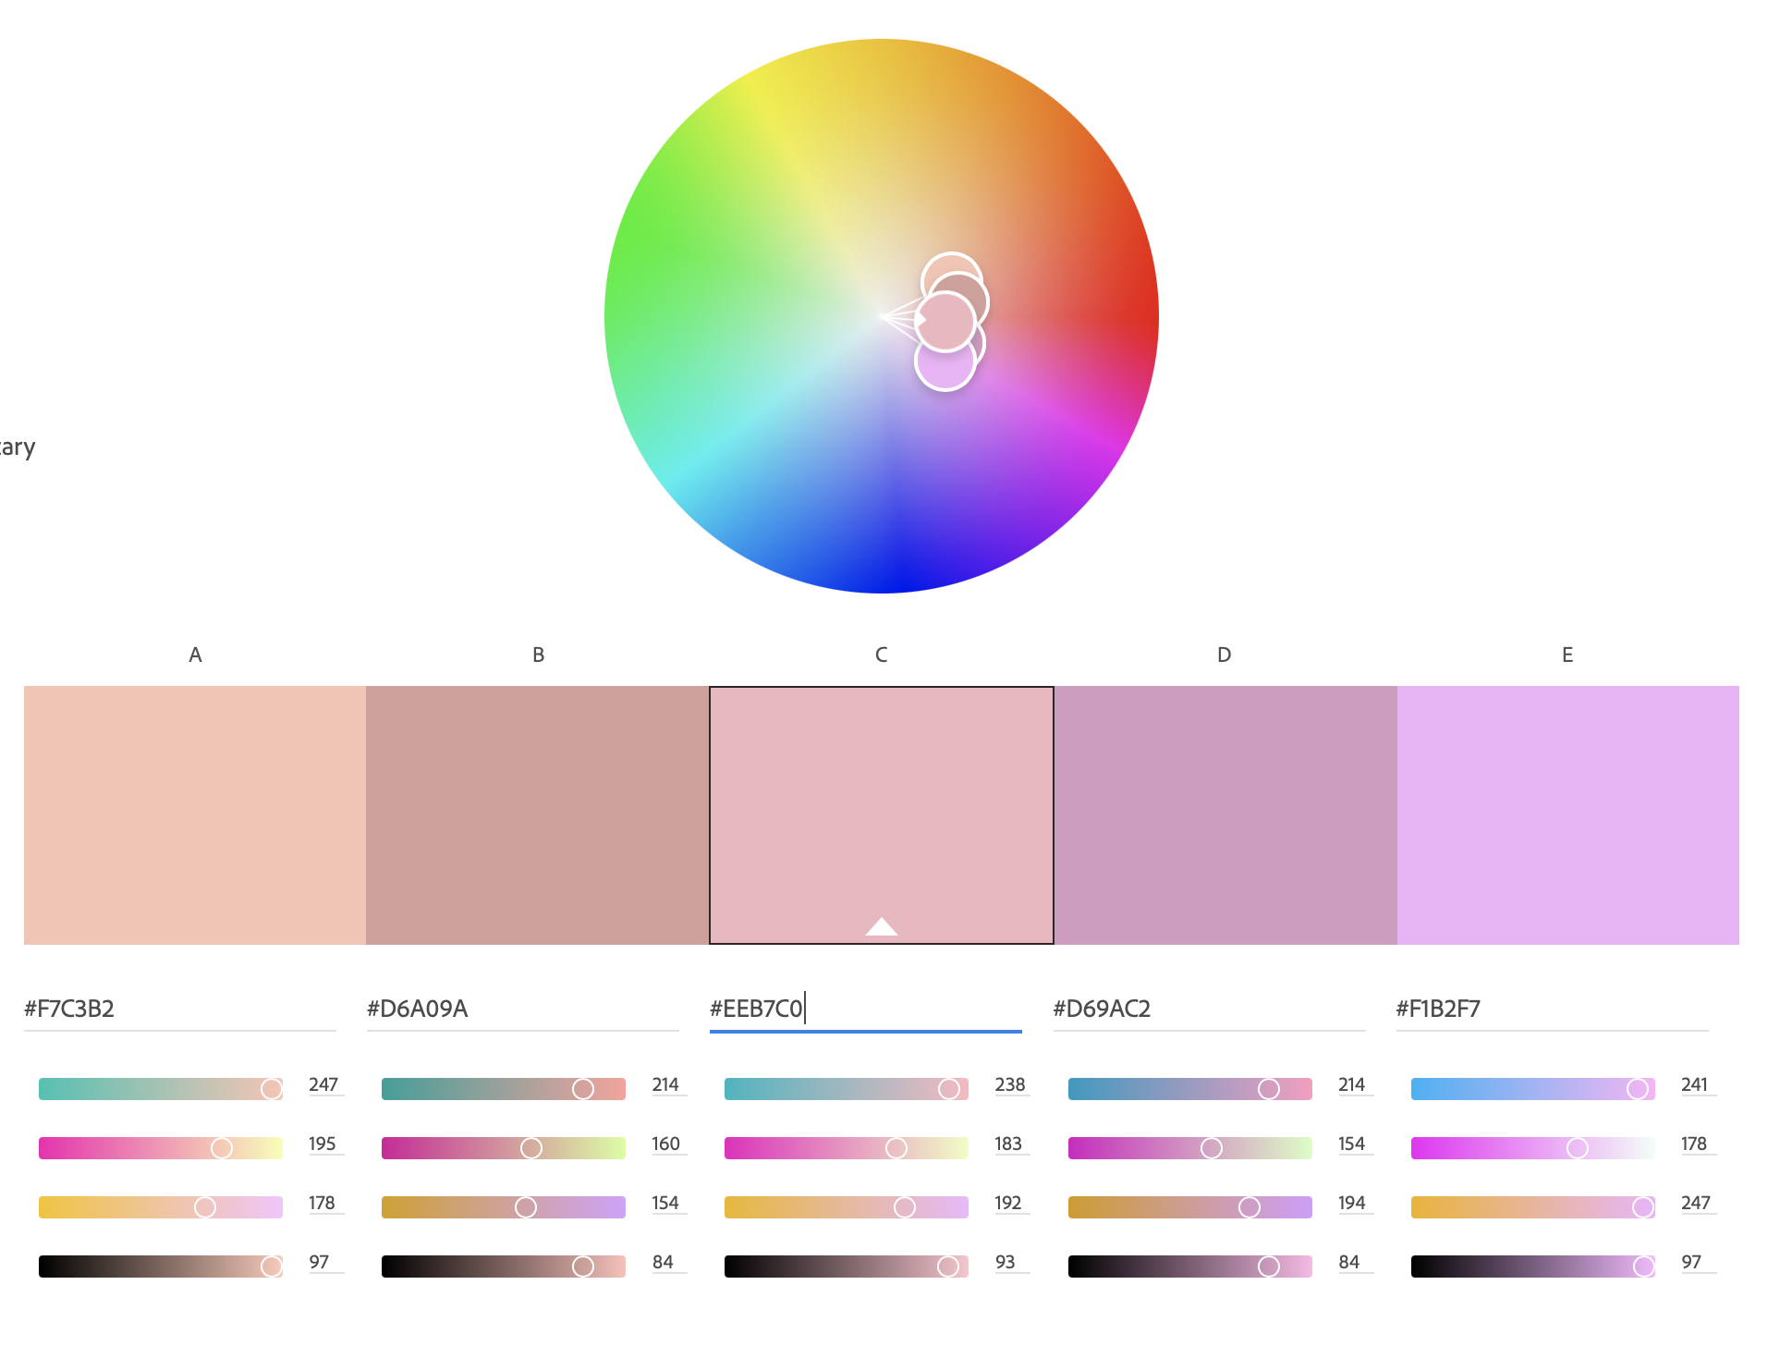
Analogous
Analogous color scheme of various shades of red shrubbery west end of Blair Hall.
#eeb70c0 (19.12%)
#aa7f82 (15.63%)
#ad5159 (12.58%)
#50322d (10.64%)
#1b1610 (10.05%)
#743b3c (7.10%)
Adobe color gives off a soft floral approach while Python gives multiple hues of a reddish pink.

Slide 4
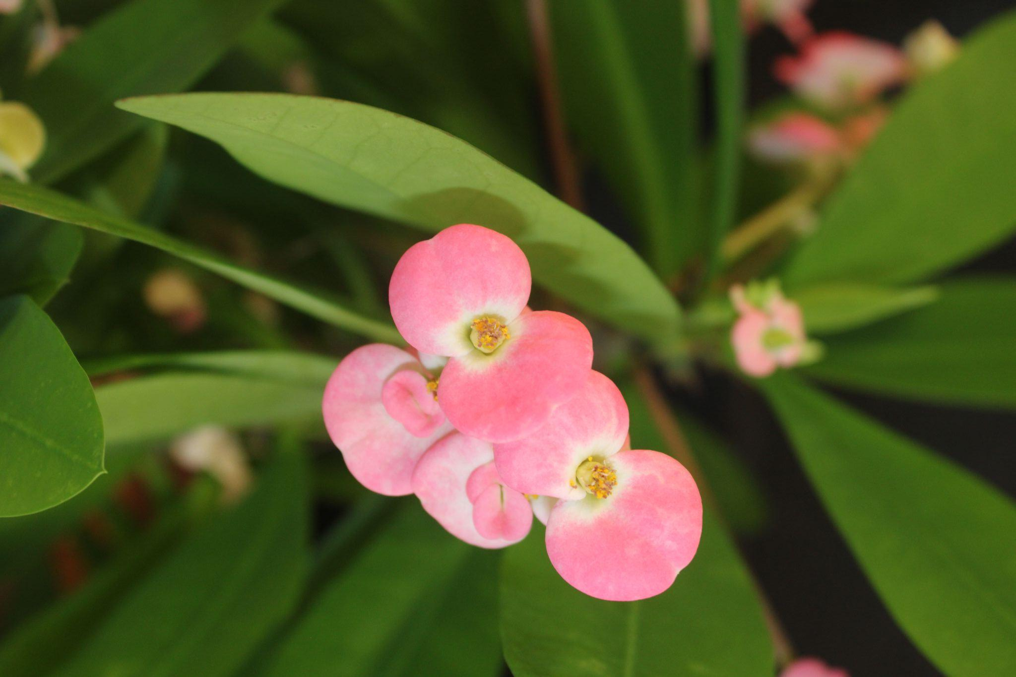
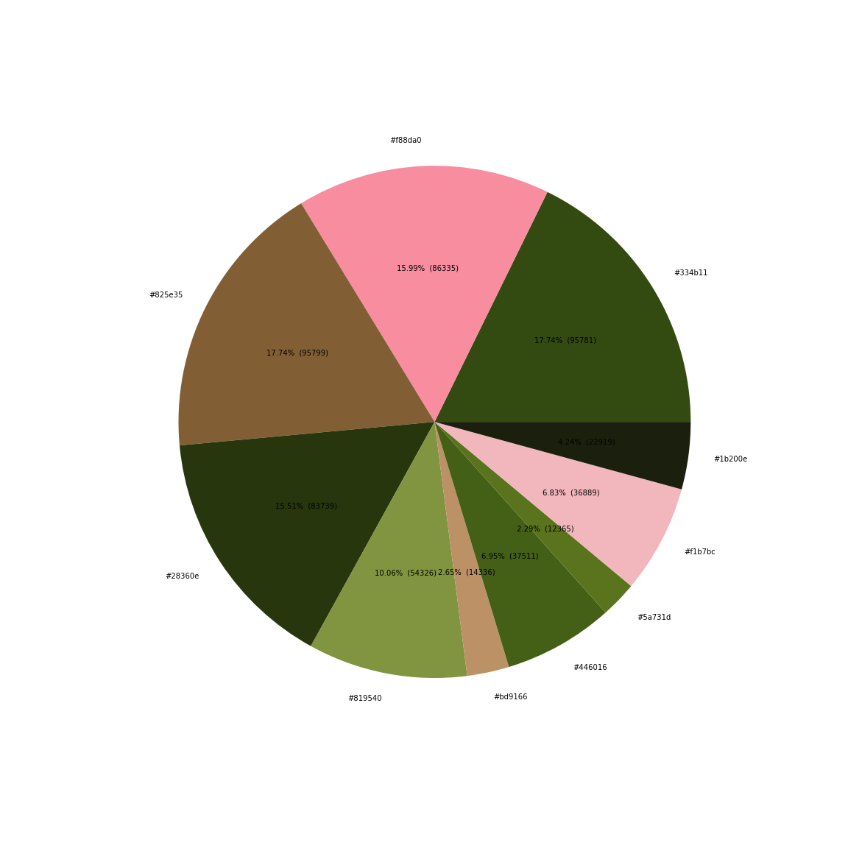
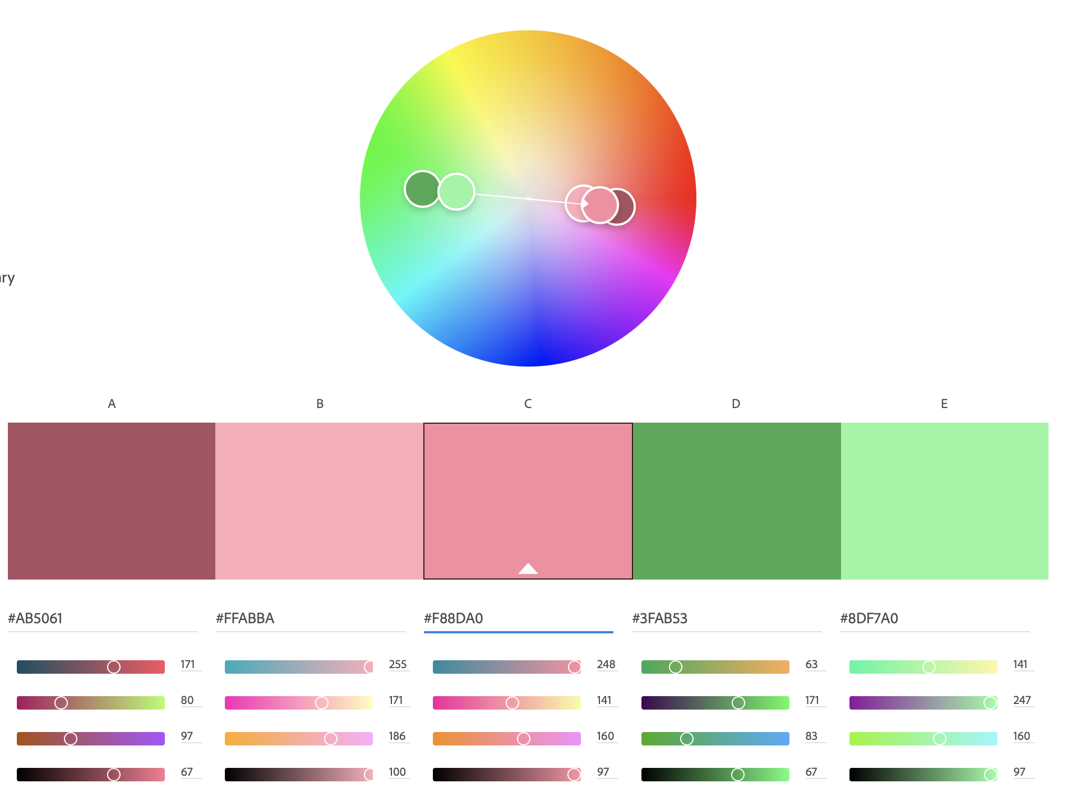
Complementary
A complementary color scheme of floral pottery that contains deep greens and a vibrant gradient of pink located in the Fine Arts department.
#334b11 (17.74%)
#825e35 ( 17.74%)
#f88da0 (15.99%)
#8360e (15.51%)
#819540 (10.06%)
#446016 (6.95%)
Both applications give great examples of complementary colors only difference being that the shades on Python represent a more rich tone while Adobe color focuses on a light spring tone.

